Slide 1
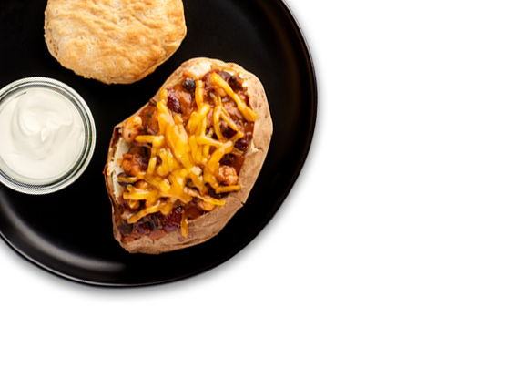
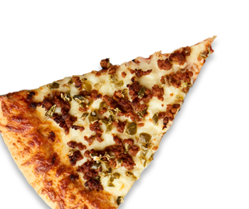
October 2023
HIGH School
MENU
Did you know….
We offer multiple fresh fruit and vegetable choices daily along with at least one hot vegetable option.
All meals must include at least ONE serving of fruit or vegetables but we encourage you to take as many as you like
 | MON |  | TUES |  | WED |  | THURS |  | FRI
2 |  | 3 |  | 4 |  | 5 |  | 6
9 |  | 10 |  | 11 |  | 12 |  | 13
16 |  | 17 |  | 18 |  | 19 |  | 20
23 |  | 24 |  | 25 |  | 26 |  | 27
30 |  | 31
Banana Choc Chip Square
Fish Sticks
Veggie Burger
Black Bean Chx Pizza
Chx Pinwheel
Bacon, Egg &
Cheese Biscuit
Chx Parmesan Flatbread
Meatball Pizza
Chx Salad Sandwich
Sausage & Cheese Slider
Egg Roll in a Bowl
Walking Taco
Cheeseburger Pizza
Ham & Cheese Sub
Choc Chip Donut
Riblet Sandwich
Hawaiian Pizza
Greek Chx Flatbread
Ham & Cheese
Flatbread
Chx Pimento Grilled Cheese
Veggie Pizza
Popcorn Chx Salad
Cinnamon Raisin
Bagel
Lasagna
Veggie Burger
White Sausage Pizza
Popcorn Chx Salad
Apple Cinnamon
Muffin
NATIONAL PASTA DAY
Spaghetti & Meatballs
Sweet Spicy Ham Pizza
Asian Chx Wrap
Sausage & Cheese Biscuit
Dumplings & Fried Rice
Cheeseburger Pizza
Turkey Mushroom Swiss Melt
Blueberry Muffin
Top
French Toast & Sausage
BBQ Chx Sriracha Pizza
Pizza Salad
Mixed Berry
Scone
Nacho Tots
Mexican Pizza
Chx Parm Flatbread
Everyday Options
Cheeseburger
Chx Sandwich
Spicy Chx Sandwich
Pepperoni Pizza
Cheese Pizza
Muffin Packs
PB&J
Breakfast Pizza
Mac & Cheese with Veggie Burger
Veggie Pesto Pizza
Popcorn Chx Salad
Chx & Cheese
Wrap
Beef Nachos
Sausage Jalapeno Pizza
Pizza Salad
Ham & Cheese
Biscuit
Popcorn Chx Bowl
Meatlover Pizza
Chipotle BBQ Meatball Sub
Cheese & Egg Tot
Taco
BBQ Chx Flatbread
Hawaiian Pizza
Chx Baja Salad
Pancake Bites
NATIONAL POTATO DAY
Potato Smiles today
Cheesy Baked Penne
Chx Pepper Popper Pizza
Chx Taco Salad
Blueberry Square
Soft Tacos
Veggie Burger
Taco Pizza
Popcorn Chx Salad
Cheesy Breakfast Sandwich
Meatloaf Cheeseburger
Greek Chx Pizza
Roasted Tomato Meatball Flatbread
Menus are subject to change.
This institution is an equal opportunity provider.

